Slide 1
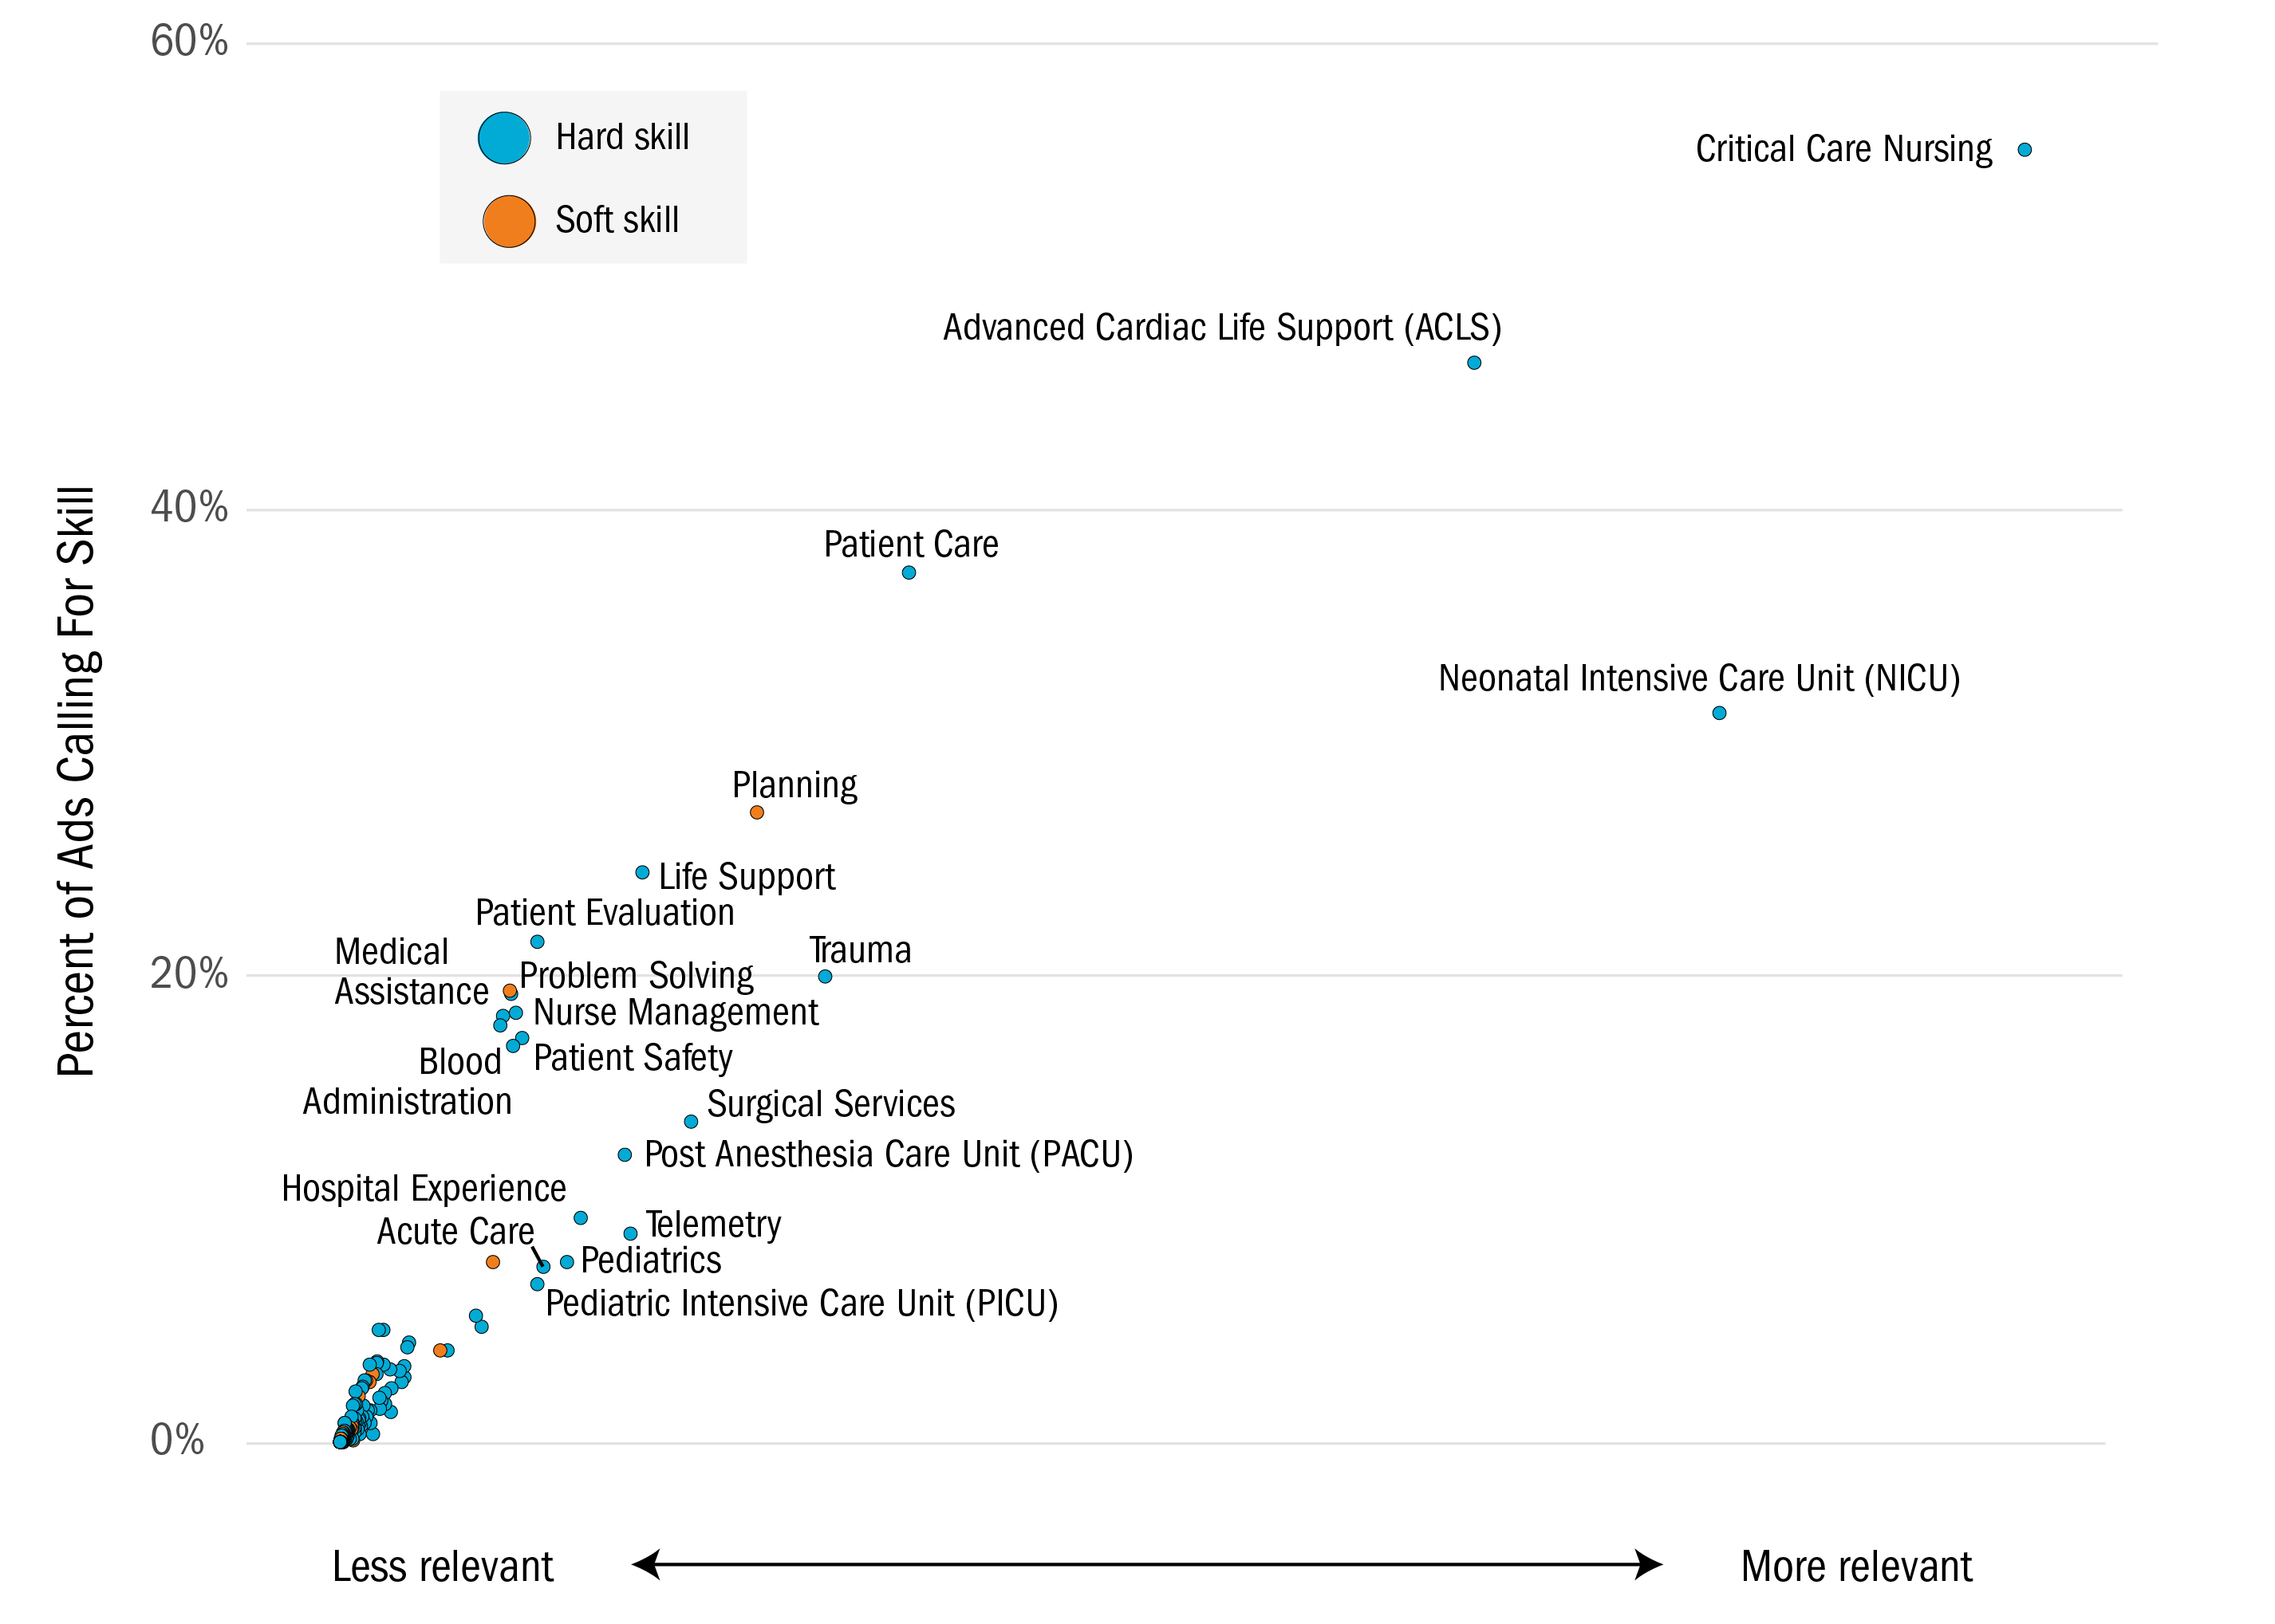
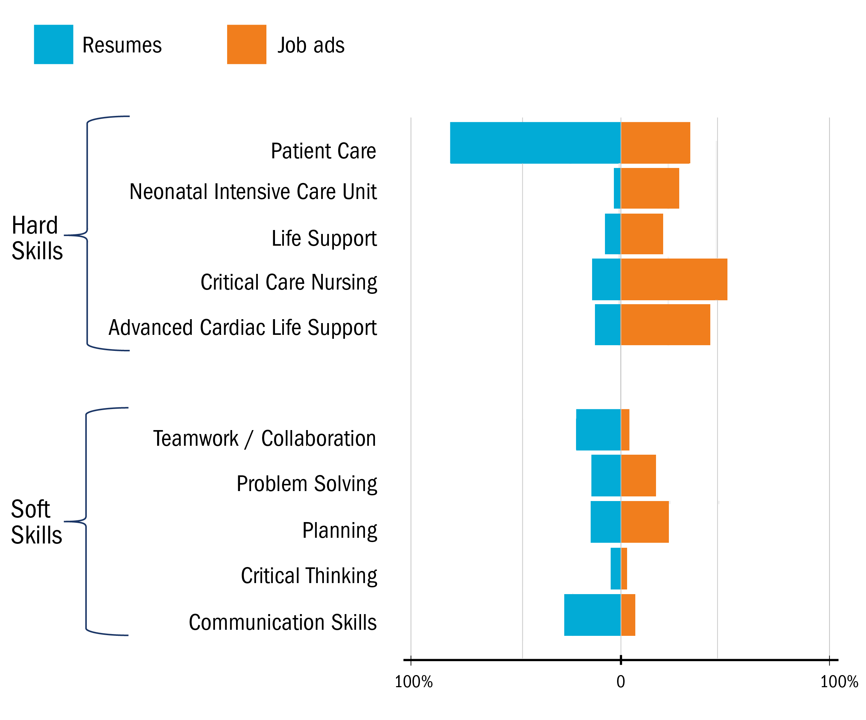
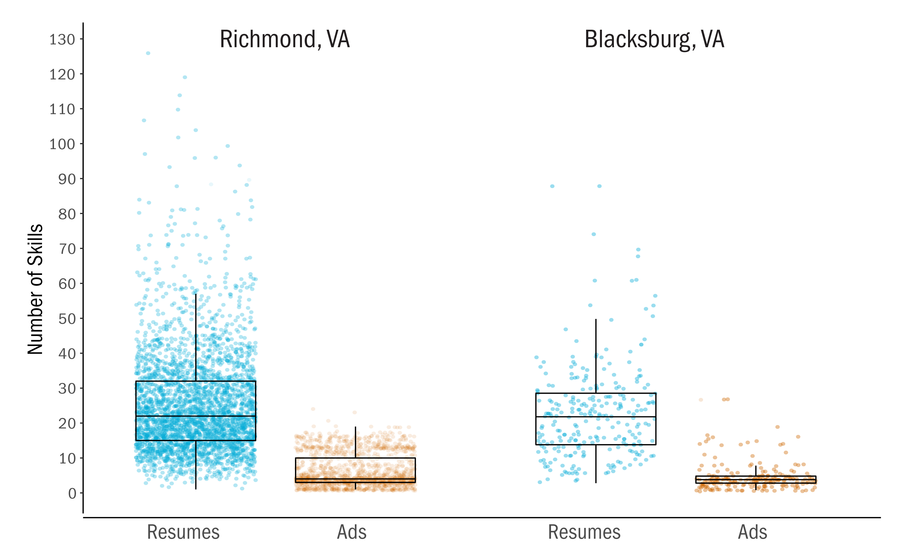
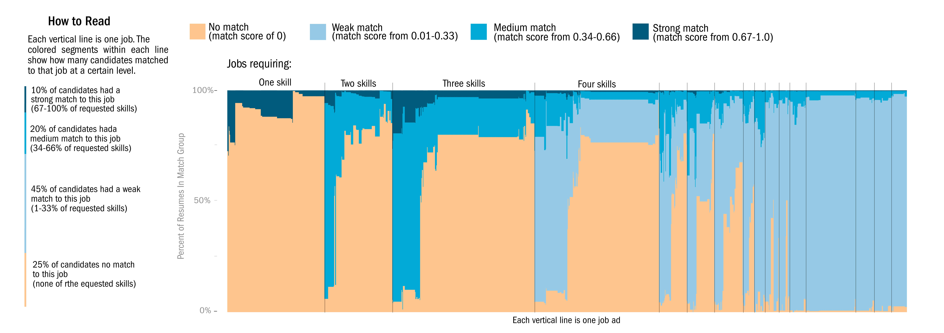
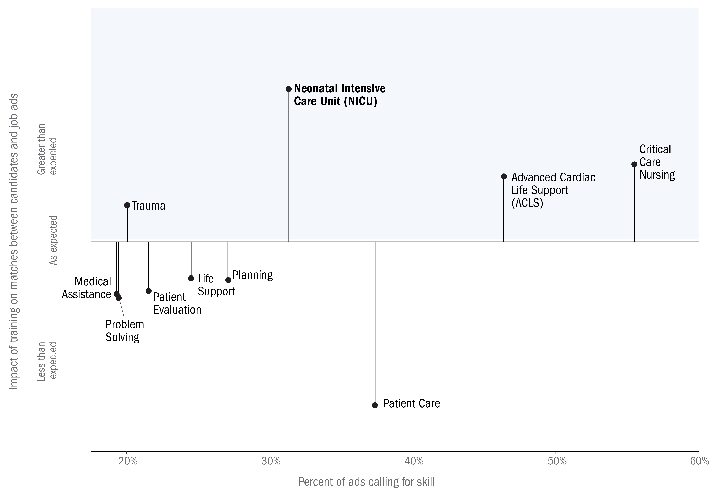
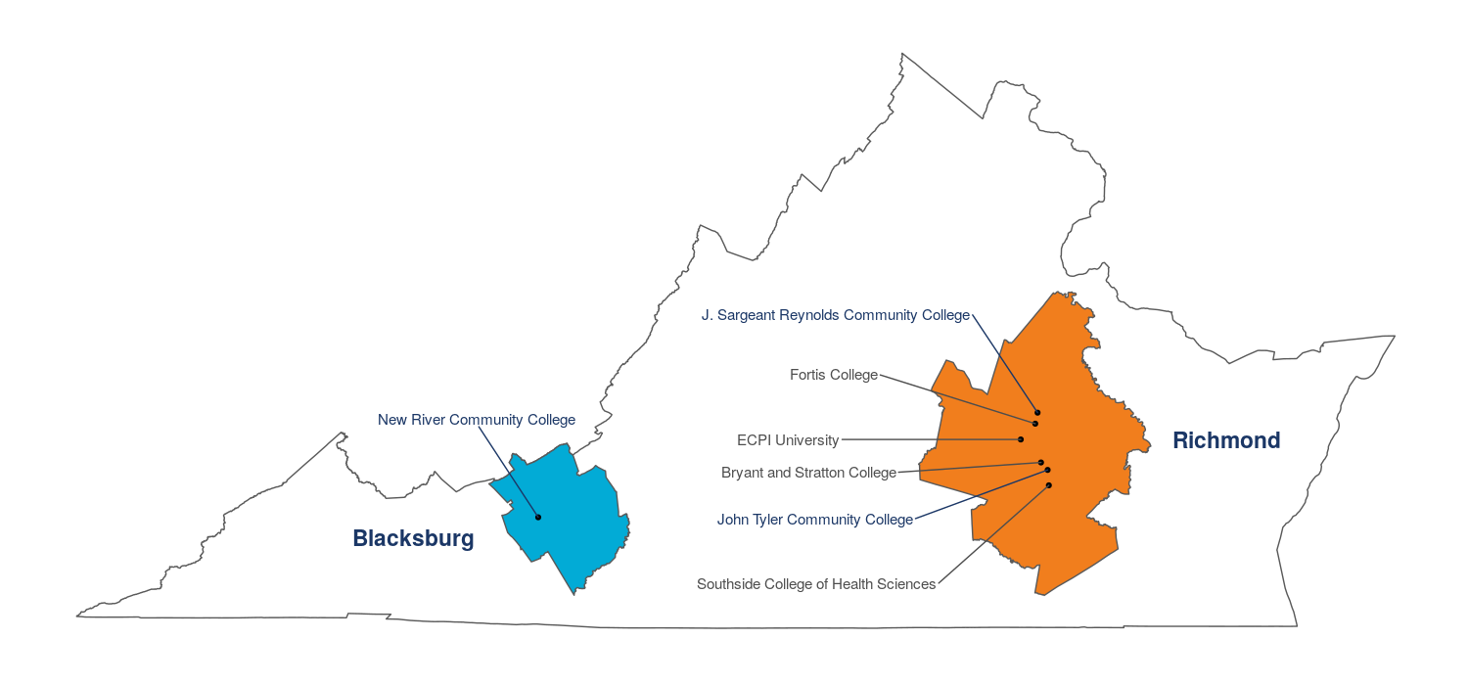

SKILLED TECHNICAL Workforce:
Demand, SUPPLY, & Pathways
A Case Study
Fellow Alyssa Fowers (University of Miami)
Students Calvin Isch (Indiana University) & Sarah McDonald (Marymount University)
Mentors Vicki Lancaster & Sam Cohen, Biocomplexity Institute and Initiative, University of Virginia
What skills are needed to enter
in-demand jobs in the Skilled Technical Workforce? How does skill supply match with demand?
Our Research
Worked with data from Burning Glass Technologies (BGT), which scrapes online job advertisements and resumes from over 50,000 sites.
Our research focused on two metropolitan areas in Virginia: Richmond and Blacksburg-Christiansburg-Radford.
Identified online job ads for STW occupations that did not require a bachelor’s degree
Critical Care Nurses were the most commonly advertised STW occupation
Identified resumes of plausible critical care nursing candidates, which listed at least one core skill for the occupation
      Richmond Population: 1,292, 911; CCN Resumes 3,150; CCN Ads: 1,609
      Blacksburg Population: 182,692; CCN Resumes: 266; CCN Ads: 245
Skilled Technical Work (STW) requires a high degree of technical knowledge, but does not necessarily require a bachelor’s degree. Skilled technical occupations offer a path to the middle class for workers without four-year degrees.
Neonatal Intensive Care Needed: Critical Care Nurses in Richmond, 2016-2017
Most relevant skills for Critical Care Nurses
Count of Skills on Job Ads and Resumes
Resumes listed many more skills than job ads in both MSAs
Top Five Hard and Soft Skills
Core skills
Percent of resumes and ads with skill
Matching Job Ads and Resumes
Matches between job ads and candidates: Critical Care Nurses
1,609 job ads matched to 3,150 candidates in Richmond, VA
Calculated the proportion of desired skills in each job that each candidate fulfilled (match score) and plotted the matches of all plausible candidates to Critical Care Nursing positions in Richmond (right).
Training in the Neonatal Intensive Care Unit (NICU) skill would have the largest impact on improving match scores (below).
Impact of skill training on matches to Critical Care Nursing jobs
Richmond, VA, 2016-2017
Pathways to Critical Care Nursing
Candidates must have first be registered nurses (RN). Six institutions in Richmond and one in Blacksburg offer associate’s degrees in nursing.
An RN can complete a Critical Care Nurse Certification (CCRN) or a Neonatal Intensive Care Nursing certification (RNC-NIC) by working with their target patient population and passing an exam.
SOCIAL AND DECISION ANALYTICS

